Slide 1

ABES INSTITUTE OF TECHNOLOGY, GHAZIABAD
DEPARTMENT OF COMPUTER SCIENCE AND ENGINEERING
Data Structure-UNIT-5 (Tree-Introduction)
BY: AVINASH KUMAR SHARMA
ASSISTANT PROFESSOR, DEPARTMENT OF CSE, ABESIT, GHAZIABAD

Slide 2
Trees
Objectives:
  Describe different types of trees.
  Describe how a binary tree can be represented using an array.
  Describe how a binary tree can be represented using an linked lists.
  Implement various operations on binary tree.

Slide 3
Introduction
Arrays, linked list ,stacks and queues are used to represent the linear and tabular data.
These structure are not suitable for representing hierarchical data.
In hierarchical data we have
  ancestor, descendant
  Superior, subordinate etc.

Slide 4
Family structure
Jaspal
Gurpreet
Navtej
Iqbal
Jaspreet
Noni
Manan
Aman

Slide 5
Business Corporate Structure
President
VP Finance
VP Personal
VP Production
VP Sales
VP Marketing

Slide 6
Federal government Structure
Federal Government
Defence
Telecomm
Finance
Education
Railways
Army
Air Force
Navy

Slide 7
Modular structure of a computer Program
Generating Invoices
Printing Packaging Slips
Accounts receivable
Processing Order

Slide 8
TREE DEFINED
A tree T is a finite non empty set of elements. One of these elements is called the root, and the remaining elements, if any, are portioned into trees, which are called the sub trees of T.

Slide 9
Introduction to Tree
Fundamental data storage structures used in programming.
Combines advantages of an ordered array and a linked list.
Searching as fast as in ordered array.
Insertion and deletion as fast as in linked list.

Slide 10
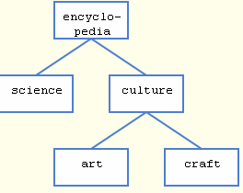
Tree (example)
node
edge

Slide 11
Tree characteristics
Consists of nodes connected by edges.
Nodes often represent entities (complex objects) such as people, car parts etc.
Edges between the nodes represent the way the nodes are related.
Its easy for a program to get from one node to another if there is a line connecting them.
The only way to get from node to node is to follow a path along the edges.

Slide 12
Tree Terminology
Subtree: tree consisting of a node and its descendants
Root: node without parent (A)
Internal node: node with at least one child (A, B, C, F)
External node (a.k.a. leaf ): node without children (E, I, J, K, G, H, D)
Ancestors of a node: parent, grandparent, grand-grandparent, etc.
Depth of a node: number of ancestors
Height of a tree: maximum depth of any node (3)
Descendant of a node: child, grandchild, grand-grandchild, etc.
Degree of an element: no. of children it has
A
subtree
B
C
D
E
F
G
H
I
J
K

Slide 13
Tree Terminology
Path: Traversal from node to node along the edges results in a sequence called path.
Root: Node at the top of the tree.
Parent: Any node, except root has exactly one edge running upward to another node. The node above it is called parent.
Child: Any node may have one or more lines running downward to other nodes. Nodes below are children.
Leaf: A node that has no children.
Subtree: Any node can be considered to be the root of a subtree, which consists of its children and its children’s children and so on.

Slide 14
Tree Terminology
Visiting: A node is visited when program control arrives at the node, usually for processing.
Traversing: To traverse a tree means to visit all the nodes in some specified order.
Levels: The level of a particular node refers to how many generations the node is from the root. Root is assumed to be level 0.
Keys: Key value is used to search for the item or perform other operations on it.

Slide 15
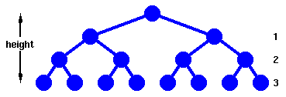
Binary Trees
Every node in a binary tree can have at most two children.
The two children of each node are called the left child and right child corresponding to their positions.
A node can have only a left child or only a right child or it can have no children at all.

Slide 16
Binary Trees
A binary tree is a tree with the following properties:
  Each internal node has at most two children (exactly two for proper binary trees)
  The children of a node are an ordered pair
We call the children of an internal node left child and right child
Alternative recursive definition: a binary tree is either
  a tree consisting of a single node, or
  a tree whose root has an ordered pair of children, each of which is a binary tree
Applications:
  arithmetic expressions
  decision processes
  searching
A
B
C
D
E
F
G
H
I

Slide 17
Arithmetic Expression Tree
Binary tree associated with an arithmetic expression
  internal nodes: operators
  external nodes: operands
Example: arithmetic expression tree for the expression (2 × (a − 1) + (3 × b))
+
×
×
2
−
3
b
a
1

Slide 18
Compiling arithmetic expressions
We can represent an arithmetic expression such as
(A + B) * (C + D) * 2 – X / Y
as a binary tree, in which the leaves are constants or variables and the nodes are operations:
6
4
–
5
3
*
/
*
2
X
Y
1
+
+
2
A post order traversal then gives us the order in which the operations have to be carried out
A
B
C
D

Slide 19
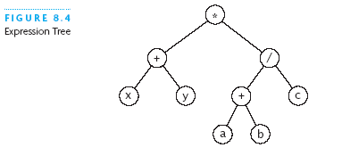
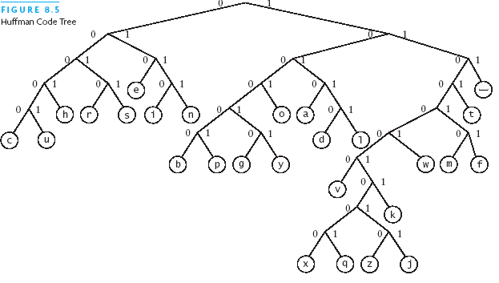
Some Types of Binary Trees (continued)

Slide 20
Properties of Proper Binary Trees
Notation
  n number of nodes
  e number of external nodes
  i number of internal nodes
  h height
Properties:
  e = i + 1
  n = 2e − 1
  h ≤ i
  h ≤ (n − 1)/2
  e ≤ 2^{h}

Slide 21
Thanks

Slide 22
ABES INSTITUTE OF TECHNOLOGY, GHAZIABAD
DEPARTMENT OF COMPUTER SCIENCE AND ENGINEERING
Data Structure-UNIT-5 (BST-Introduction & Implementation)
BY: AVINASH KUMAR SHARMA
ASSISTANT PROFESSOR, DEPARTMENT OF CSE, ABESIT, GHAZIABAD

Slide 23
Binary Search Trees
Binary Search Trees:
A binary search tree T is a binary tree that may be empty. A non empty binary search tree satisfies the following properties:
Every element has a key (or value) and no two elements have the same key i.e. all keys are unique.
The keys, if any, in the left subtree of the root are smaller than the key in the node.
The keys, if any, in the right subtree of the root are larger than the key in the node.
The left and right subtrees of the root are also binary search trees.

Slide 24
BST
70
40
70
60
80
10
55
80
30
62
75
92
5
12
75
92
Fig.(a)
Fig. (b)
Fig. ©
Binary search trees

Slide 25
Representation of Binary & BST
Array Representation
Linked list representation

Slide 26
Array Representation
In this representation the binary tree is represented by storing each element at the array position corresponding to the number assigned to each number (nodes)
In this representation, a binary tree of height h requires an array of size (2^{h}-1), in the worst case

Slide 27
Array Representation
For simplicity , I am considering the array is indexed with an index set beginning from 1 not 0.
1
2
3
4
5
6
7
70
60
80
30
62
75
92
Array representation of BST in fig (a)
1
2
3
4
5
6
7
40
10
55
5
12
Array representation of BST in fig (b)
1
2
3
4
5
6
7
70
80
75
92
Array representation of BST in fig (c)

Slide 28
BST
70
72
80
85
Fig. (d)
1
2
3
4
5
6
7
8
9
10
11
12
13
14
15
70
72
80
85

Slide 29
Disadvantages of array representation
This scheme of representation is quite wasteful of space when binary tree is skewed or number of elements are small as compared to its height.
Array representation is useful only when the binary tree is full or complete.

Slide 30
Linked representation
The most popular and practical way of representing a binary tree is using links (pointers).
70
60
80
X
30
X
X
62
X
X
75
X
X
92
X
Linked representation of binary search tree of figure (a)

Slide 31
Linked representation
40
10
X
55
X
X
5
X
X
12
X
Linked representation of binary search tree of figure (b)

Slide 32
Linked representation
X
70
80
X
75
X
X
92
X
Linked representation of binary search tree of figure (c)

Slide 33
Linked representation
X
70
X
72
X
80
X
85
X

Slide 34
Linked Representation
In linked representation, each element is represented by a node that has exactly two link fields.
Field names are left and right.
Each node has data field called info.
The node structure is defined as:
struct nodetype
{
struct nodetype *left;
int info;
struct nodetype *right;
};

Slide 35
Implementation of binary tree will consider following declarartion
typedef struct nodetype
{
struct nodetype *left;
int info;
struct nodetype *right;
}BST;
BST root;
Here , I have defined a new datatype and given it name BST, then I have declared a pointer variable root to represent the binary (search) tree.

Slide 36
Common operation on binary and binary search trees
Some of the operations that are commonly performed on binary as well as binary search trees:
Creating an empty tree.
Traverse it
Determine its height.
Determine the number of elements in it.
Determine the no of internal nodes i.e. non leaf nodes.
Determine the no of external nodes i.e. leaf nodes.
Determine its mirror image.
Remove it from memory.

Slide 37
Operations that are performed on only with binary search trees
Insert a new node.
Search an element.
Find the smallest element.
Find the largest element.
Delete a node.

Slide 38
1. Creating an empty Binary (Search) Trees
void createtree(BST **tree)
{
*tree=NULL;
}

Slide 39
Thanks

Slide 40
ABES INSTITUTE OF TECHNOLOGY, GHAZIABAD
DEPARTMENT OF COMPUTER SCIENCE AND ENGINEERING
Data Structure-UNIT-5 (Binary Tree Traversal)
BY: AVINASH KUMAR SHARMA
ASSISTANT PROFESSOR, DEPARTMENT OF CSE, ABESIT, GHAZIABAD

Slide 41
2. Traverse a binary tree
Preorder ( depth first order )
    1. Visit the root
    2. Traverse the left subtree in preorder.
    Traverse the right subtree in preorder.
Inorder (Symmetric order )
1. Traverse the left subtree in inorder.
2. Visit the root.
3. Traverse the right subtree in inorder.

Slide 42
Traverse a binary tree
Postorder
    1. Traverse the left subtree in postorder.
    Traverse the right subtree in postorder.
    3. Visit the root.

Slide 43
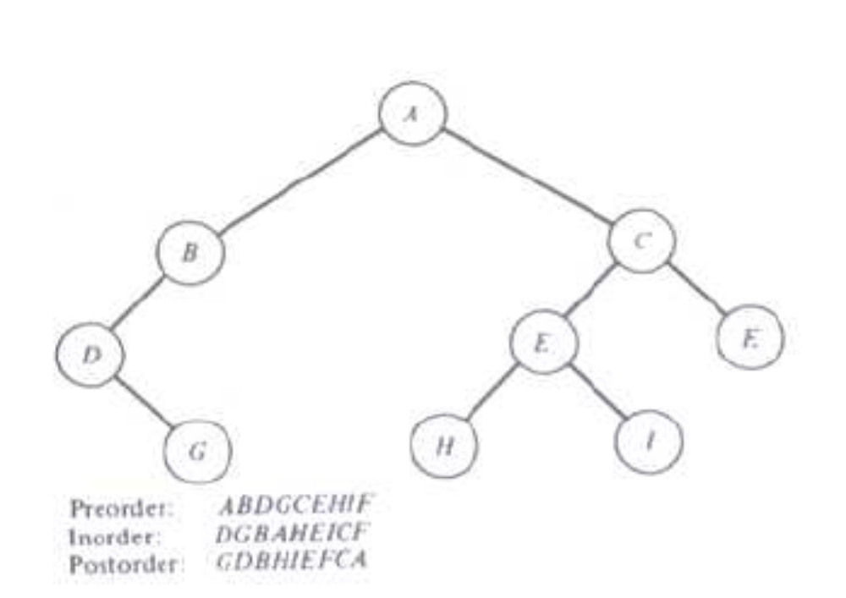
Traverse a binary tree

Slide 44
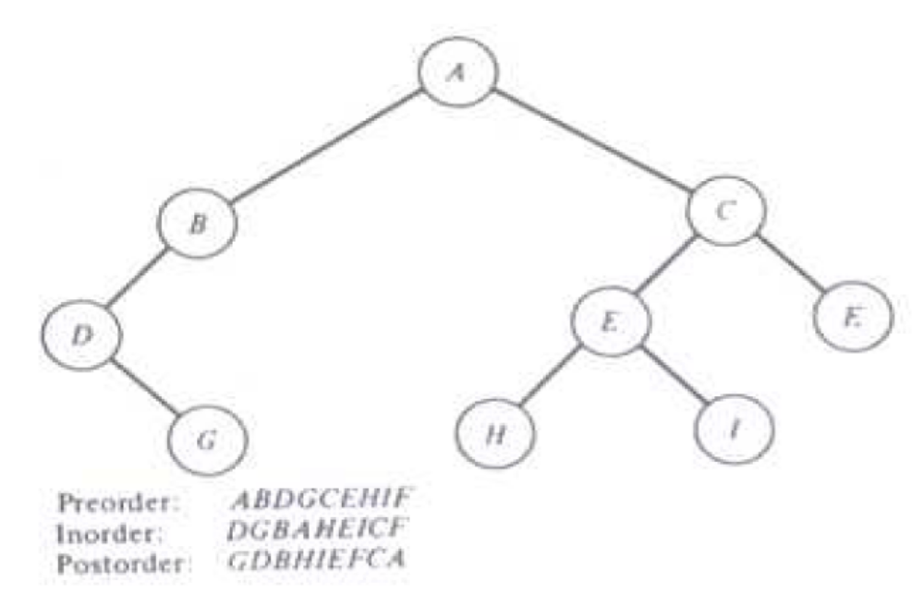
Traverse a binary tree

Slide 45
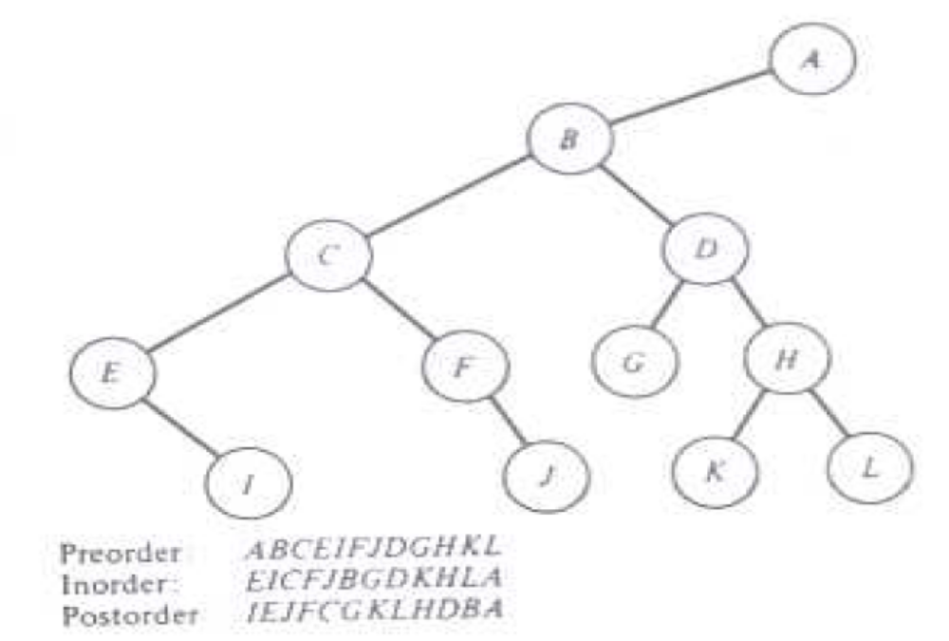
Traverse a binary tree

Slide 46
Traversing of Binary (search) tree
Pre-order Traversal:
void pre(BST *tree)
{
if(tree!=NULL)
{
printf(“%d”,tree->info);
pre(tree->left);
pre(tree->right);
}
}

Slide 47
IN-Order Traversal
void inorder(BST *tree)
{
if(tree!=NULL)
{
inorder(tree->left);
printf(“%d”,tree->info);
inorder(tree->right);
}
}

Slide 48
Post order traversal
void postorder(BST *tree)
{
if(tree!=NULL)
{
postorder(tree->left);
postorder(tree->right);
printf(“%d”,tree->info);
}
}

Slide 49
Example
Pre-order: A B D E G H C F
In order: D B G E H A C F
Draw the binary tree T.

Slide 50
Example
Pre- Order:
A
B D E G H
C F
Root
Left subtree L_{TA}
Right subtree R_{TA}
In- Order:
B D G E H
A
C F
Left subtree L_{TA}
Root
Right subtree R_{TA}

Slide 51
Example:
Partial Tree
A
D B
G E H
C F
R_{TA}
L_{TA}
Pre- Order:
B D E G H
In- Order:
D B G E H

Slide 52
Example
Pre- Order:
B
D
E G H
Root
Left subtree L_{TB}
Right subtree R_{TB}
In- Order:
D
B
G E H
Left subtree L_{TB}
Root
Right subtree R_{TB}

Slide 53
Example:
Partial Tree
A
B
C F
R_{TA}
D
G
E H
R_{TB}
Pre- Order:
E G H
In- Order:
G E H

Slide 54
Example
Pre- Order:
E
G
H
Root
Left subtree L_{TE}
Right subtree R_{TE}
In- Order:
G
E
H
Left subtree L_{TE}
Root
Right subtree R_{TE}

Slide 55
Example:
Partial Tree
A
B
C F
R_{TA}
D
E
G
H
Pre- Order:
C F
In- Order:
C F

Slide 56
Example
Pre- Order:
C
F
Root
Left subtree L_{TC}
Right subtree R_{TC}
In- Order:
C
F
Left subtree L_{TC}
Root
Right subtree R_{TC}

Slide 57
Example:
A
B
C
D
E
F
G
H

Slide 58
Thanks

Slide 59
ABES INSTITUTE OF TECHNOLOGY, GHAZIABAD
DEPARTMENT OF COMPUTER SCIENCE AND ENGINEERING
Data Structure-UNIT-5 (Binary Tree Operations)
BY: AVINASH KUMAR SHARMA
ASSISTANT PROFESSOR, DEPARTMENT OF CSE, ABESIT, GHAZIABAD

Slide 60
Determining the height of the binary tree
We find the height of the left sub tree and right sub tree of given node.
Height of the binary tree at a given node will be equal to maximum height of the left and right sub tree plus 1.
Program in the next slide shows the implementation of various steps required.

Slide 61
Determining the height of the binary tree
Int height(BST *tree)
{
int lheight,rheight;
if(tree==NULL)
{
return 0;
}
else
{
lheight=height(tree->left);
rheight=height(tree->right);
if(lheight>rheight)
return ++lheight;
else
return ++rheight;
}
}

Slide 62
Determining number of nodes/elements
Any of the traversal scheme can be used to determine the number of element.
The approach we use that is
  Number of elements in the tree is equal to number of nodes in left sub tree plus number of nodes in right sub tree plus one.

Slide 63
Determining number of nodes/elements
Int totalnodes(BST *tree)
{
if(tree==NULL)
return 0;
else
return (totalnodes(tree->left)+totalnodes(tree->right) + 1);
}

Slide 64
Inserting a New Element
If the binary search tree is initially empty, then the element is inserted as root node.
Otherwise the element is inserted as terminal node.
If the element is less than the element in the root node, then the element is inserted in the left sub tree else right sub tree.

Slide 65
BST
50
25
75
20
40
60
80
10
30
45
65
85
Suppose you want to insert 55

Slide 66
Inserting a new element
Void insertelement(BST *tree, int element)
{
BST *ptr,*nodeptr,*parentptr;
ptr=(BST*)malloc(sizeof(BST));
ptr->info=element;
ptr->left=ptr->right=NULL;
if(tree==NULL)
*tree=ptr;
else
{
parentptr=NULL;
nodeptr=*tree;
while(nodeptr!=NULL)
{
parentptr=nodeptr;
if(element<nodeptr->info)
nodeptr=nodeptr->left;
else
nodeptr=nodeptr->right;
}
if(element<parentptr->info)
parentptr->left=ptr;
else
parentptr->right=ptr;
}
}

Slide 67
Searching an element
The element in binary search tree can be searched very quickly.
Search operation on binary tree is similar to applying binary search technique to a sorted linear array.
The element to be searched will be compared with root node.
If matches with the root node then search terminates here.
Otherwise search is continued in the left sub tree if the element is less then the root or in the right sub tree if the element is greater then the root.

Slide 68
The Find Operation…
*root
6
2
9
5
7
10
Suppose I try to find the
node with 7 in it. First go
down the right subtree, then
go down the left subtree.

Slide 69
Searching an element
BST searchelement(BST *tree, int value)
{
if((tree->info==value)||tree==NULL)
return tree;
else if(value<tree->info)
return searchelement(tree->left, value);
else
return searchelement(tree->right, value);
}

Slide 70
Finding smallest node
Because of the property of binary search tree, we know that the smallest node in the tree will be one of the nodes in the left sub tree, if it exists;
otherwise node itself will be the smallest node.
BST smallest(BST *tree)
{
if((tree==NULL)||(tree->left==NULL))
return tree;
else
return smallest(tree->left);
}

Slide 71
The FindMin Operation…
*root
6
2
9
5
7
10
This function returns a pointer to the node containing the
smallest element in the tree. It does so by following the left
side of the tree.

Slide 72
Finding largest node
Because of the property of binary search tree, we know that the largest node in the tree will be one of the nodes in the right sub tree, if it exists;
otherwise node itself will be the largest node.
BST largest(BST *tree)
{
if((tree==NULL)||(tree->right==NULL))
return tree;
else
return largest(tree->right);
}

Slide 73
The FindMax Operation…
*root
6
2
9
5
7
10
This function returns a pointer to the node containing the
largest element in the tree. It does so by following the right
side of the tree.

Slide 74
Deleting a node
To delete a node, the following possibilities may arise:
Node is terminal node: in this case if node is left child of its parent, then the left pointer of its parent is set to NULL, otherwise it will be right child of its parent and accordingly pointer of its parent is set to NULL.
Node having only one child: in this case, the appropriate pointer of its parent is set to child, thus by passing it.
Node having two children: predecessor replaces node value, and then the predecessor of node is deleted.

Slide 75
BST
50
25
75
20
40
60
80
10
30
45
65
85
Suppose we want to delete 75

Slide 76
BST
50
25
20
40
60
80
10
30
45
65
85
50<75 proceed right , delete 75

Slide 77
BST
50
25
80
20
40
60
10
30
45
65
85
Since node has both right and left child, if right sub tree is opted find the smallest node, if left sub tree is opted find the largest node

Slide 78
BST
50
25
80
20
40
60
85
10
30
45
65
Since node has child, if right sub tree is opted find the smallest node, if left sub tree is opted find the largest node

Slide 79
BST
50
25
80
20
40
60
85
10
30
45
65
Since node->right=node->left=NULL, delete the node and place NULL in the parent node

Slide 80
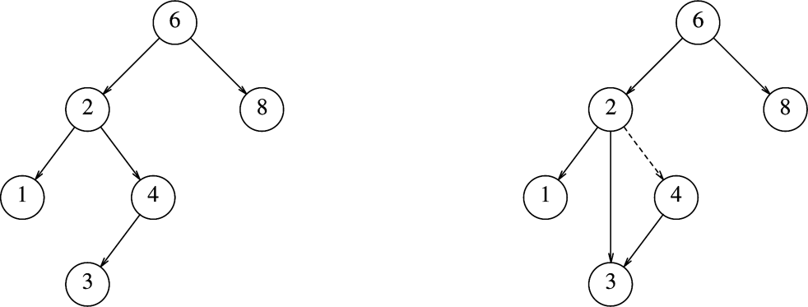
BST: Deletion
Deleting a node with one child
Before delete(4)
After delete(4)
Deletion Strategy: Bypass the node being deleted

Slide 81
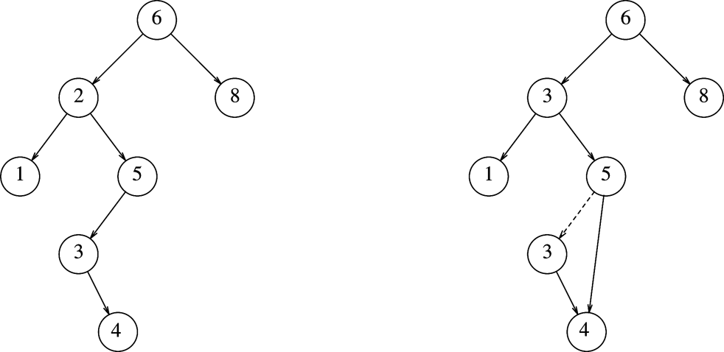
BST: Deletion (contd.)
Deleting a node with two children
After delete(2)
Before delete(2)
Deletion Strategy: Replace the node with
smallest node in the right subtree

Slide 82
The Removal Operation
If the node to be removed is a leaf, it can be deleted immediately.
If the node has one child, the node can be deleted after its parent adjusts a link to bypass the deleted node.
*root
6
What if the 2 is deleted?
2
9
5
7
10

Slide 83
Removal…
*root
*root
6
6
t
2
2
9
9
t → right
5
7
10
5
7
10
Set t = t → right

Slide 84
Removal…
If the node to be removed has two children, the general strategy is to replace the data of this node with the smallest data of the right subtree.
Then the node with the smallest data is now removed (this case is easy since this node cannot have two children).

Slide 85
Removal…
Remove the 2 again…
*root
*root
6
6
2
3
9
9
1
5
7
10
1
5
7
10
3
3
4
4

Slide 86
The Removal Operation
delBST(root, delkey)
if(empty tree)
return false
endif
2. If (delkey<root)
rerturn delBST(leftsubtree, delkey)
3. else if(delkey>root)
rerturn delBST(rightsubtree, delkey)
4. Else
if(no left subtree)
make right subtree the root
return true.
else if(no right subtree)
make left subtree the root
return true.
else
save root in deletenode
set largest to largestBST(left subtree)
move data in largest to deletenode
return delBST(left subtree of deletenode, key of the largest)
endif
endif
End delBST

Slide 87
23 is to be deleted find delkey
17
9
23
5
11
21
27
20
22

Slide 88
Find largest data
22 is the largest key on the left subtree
17
9
23
5
11
21
27
20
22

Slide 89
Move largest data
17
9
22
5
11
21
27
20
22

Slide 90
Delete largest node
17
9
23
5
11
21
27
20

Slide 91
Thanks

Slide 92
AVL TREES
We can guarantee O(log₂n) performance for each search tree operation by ensuring that the search tree height is always O(log₂n).
Trees with a worst case height of O(log₂n) are called balanced trees.
One of the popular balanced tree is AVL tree, which was introduced by Adelson-Velskii and Landis.

Slide 93
AVL TREES
If T is non empty binary tree with T_{L} and T_{R} as its left and right sub tree, then T is an AVL tree if and only if:
|h_{L}-h_{R}|<=1, where h_{L} and h_{R} are the heights of T_{L} and T_{R} respectively.
T_{L} and T_{R} are AVL trees

Slide 94
AVL TREES
+1
70
0
70
0
60
-1
80
+1
60
80
0
0
62
0
75
0
92
0
30
Fig (a)
Fig (b)

Slide 95
Representation of AVL trees
The node of the AVL tree is additional field bf (balanced factor) in addition to the structure to the node in binary search tree.
typedef struct nodetype
{
struct nodetype *left;
int info;
int bf;
struct nodetype *right;
}avlnode;
avlnode *root;

Slide 96
AVL TREES
The value of the field bf will be chosen as:
-1 if h_{L}<h_{R}
bf = 0 if h_{L}=h_{R}
+1 if h_{L}>h_{R}

Slide 97
Operation on AVL TREES
Insertion of a node: The new node is inserted using the usual binary search tree insert procedure i.e. comparing the key of the new node with that in the root, and inserting new node into left or right sub tree as appropriate.
After insertion of new nodes two things can be changed i.e.
  Balanced factor
  height

Slide 98
AVL TREES
0
0
8
8
-1
5
10
-1
-1
5
10
0
7
0
15
0
0
7
0
15
0
9
Original AVL Tree
After inserting value 9
Neither the balance factor nor the height of the AVL tree is affected

Slide 99
AVL TREES
+1
0
8
8
-1
5
10
0
-1
5
10
-1
7
0
7
0
15
0
Original AVL Tree
After inserting value 15
Height remains unchanged but the balance factor of the root gets changed

Slide 100
AVL TREES
+2
+1
8
8
-1
0
5
10
0
5
10
0
3
0
7
+1
3
0
0
7
6
0
Original AVL Tree
After inserting value 6
Height as well as balanced factor gets changed. It needs rearranging about root node
In order to restore the balance property, we use the tree rotations

Slide 101
AVL TREES
-2
35
0
0
60
20
60
-1
Rotate left
0
35
65
-1
45
0
65
-1
20
0
45
0
70
0
70
0
Total height 4
Total height 3
Restoring balance by left rotation

Slide 102
AVL TREES
+2
35
0
+1
30
30
50
0
Rotate right
+1
25
35
0
25
+1
33
0
0
0
10
33
50
0
10
0
Total height 4
Total height 3
Restoring balance by right rotation

Slide 103
AVL TREES
+2
+2
35
35
-1
+1
20
50
0
23
50
0
Rotate left
0
0
-1
32
10
23
20
+1
Total height 4
0
10
0
32
0
Rotate right
23
+1
20
35
0
0
0
10
32
50
0
Restoring balance by double rotation

Slide 104
ABES INSTITUTE OF TECHNOLOGY, GHAZIABAD
DEPARTMENT OF COMPUTER SCIENCE AND ENGINEERING
Data Structure-UNIT-5 (Threaded Binary Tree)
BY: AVINASH KUMAR SHARMA
ASSISTANT PROFESSOR, DEPARTMENT OF CSE, ABESIT, GHAZIABAD

Slide 105
Threaded Binary trees
On carefully examining the linked representation of a binary tree T , we will find that approximately half of the pointer fields contains NULL entries.
The space occupied by these NULL entries can be utilized to store valuable information.
One way to utilize this space is that we can store special pointer that points to nodes higher in the tree, i.e. ancestors.
These special pointer are called threads, and the binary tree having such pointers is called a threaded binary tree.
In computer memory, an extra field, called tag or flag is used to distinguish thread from a normal pointer.

Slide 106
Threaded Binary trees
There are many ways to thread a binary tree:
The right NULL pointer of each node can be replaced by a thread to the successor of the node under in-order traversal called a right thread, and the tree will called a right threaded tree.
The left NULL pointer of each node can be replaced by a thread to the predecessor of the node under in-order traversal called a left thread, and the tree will called a left threaded tree.
Both left and right NULL pointers can be used to point to predecessor and successor of that node respectively, under in-order traversal. Such a tree is called a fully threaded tree.
A threaded binary tree where only one thread is used is known as one way threaded tree and where both thread are used called two way threaded tree.

Slide 107
Right threaded binary tree (one way threading)
A
B
C
X
F
G
X
D
X
E
X
X
H

Slide 108
Left threaded binary tree (one way threading)
A
B
C
X
F
G
X
D
E
X
H
X

Slide 109
Fully threaded binary tree (two way threading)
A
B
C
X
F
G
D
E
X
H

Slide 110
Representation of threaded binary tree in memory
typedef struct nodetype
{
struct nodetype *left;
int info;
char thread;
struct nodetype *right;
}TBST;
TBST *root;
In this representation, we have used char field thread as a tag. The character ‘0’ will used for normal right pointer and character ‘1’ will be used for thread.

Slide 111
Thanks

Slide 112
Heaps
Objectives:
Describe a heap
Describe how a heap can be represented in memory
Implement the various operations on heap
Describe the applications of heaps

Slide 113
Introduction
Heap is binary tree that satisfies the following properties:
Shape property
Order property
By the shape property we mean that heap must be complete binary tree.
By order property we mean that every node in the heap, the value stored in that node is greater than or equal to the value in each of its children. A heap that satisfy the above property is known as max. heap.
if every node in the heap is less than or equal to the value in each of its children. that heap is known as min. heap.

Slide 114
Heaps
20
50
25
27
40
35
33
35
40
50
25
20
27
33
Fig.(a) Max. heap
Fig.(b) Min. heap

Slide 115
Representation of heap in memory
A heap is represented in memory using linear array i.e by sequential representation
Since a heap is a complete or nearly complete binary tree, therefore a heap of size n is represented in memory using a linear array of size n.

Slide 116
Representation of heap in memory
Heap
1
50
Heap
50
2
40
3
35
40
35
4
25
5
20
25
20
27
33
6
27
7
33
Max. heap with 7 elements
Sequential representation of max heap

Slide 117
Operation on heaps
Deleting an element from the heap:
Element from the heap is always deleted from root of the heap.
If we delete element from the root it create hole, vacant space , in root position
Because heap must be complete, we fill the hole with the last element of the heap.

Slide 118
Deleting an element from the heap
Although heap becomes complete i.e satisfies shape property, the order property of heap is violated.
As the value come from the bottom is small.
We have to do another operation to satisfy the order property.
This operation involves moving the element down from the root position until either it ends up in a position, where the root property is satisfied or it hits the leaf node.
This operation in text will be referred as reheapify downward operation.

Slide 119
Deleting an element from the heap
50
40
35
25
20
27
33
Starting heap
33
40
35
25
20
27
After removing 50 and replacing with 33

Slide 120
Deleting an element from the heap
40
33
35
25
20
27
Reheapify downward from root node (swap 33 with 40)

Slide 121
Deleting an element from the heap
ReheapifyDownward(heap,start,finish)
Here heap is a linear array, start is the index of the element from where reheapify downward operation is to start, and finish is the index of last element of the heap. The variable index is used to keep track of index of the largest child.
Begin
if heap[start] is not leaf node then
set index=index of the child with largest value
if(heap[start]<heap[index]) than
swap heap[start] and heap[index]
call ReheapifyDownward(heap,index,finish)
endif
endif
end

Slide 122
Void reheapifyDownward(int heap[],int start,int finish)
{
int index,lchild,rchild,maximum,temp;
lchild=2*start; /*index of the left child*/
rchild=lchild+1; /*index of the right child*/
if(lchild<=finish)
{
maximum=heap[lchild];
index=lchild;
if(rchild<=finish)
{
if(heap[rchild]>maximum)
{
maximum=heap[rchild];
index=rchild;
}
}
if(heap[start<heap[index])
{
temp=heap[start];
heap[start]=heap[index];
heap[index]=temp;
reheapifyDownward(heap,index,finish)
}
}
}

Slide 123
The deletion from the heap is done in following steps:
Assign the value of the root to the temporary variable, which may be required for further processing.
Bring the last element of the heap to the root node position.
Reduce the size of the heap by factor of one.
Apply reheapify downward operation from root node.

Slide 124
Deleting an element from the heap
DeleteElemet(heap,n,item)
Here heap is the linear array with size n. this algorithm deletes the element from the root of heap and assign to item through which it is returned to the calling program.
Begin
set item=heap[1]
set heap[1]=heap[n]
set n=n-1;
Call reheapifyDownward(heap,1,n)
End

Slide 125
Deleting an element from the heap
Int delementElement(int heap[],int *n)
{
int temp;
temp=heap[1];
heap[1]=heap[*n];
(*n)--;
reheapifydownward(heap,1,n);
return temp;
}

Slide 126
Inserting an element into heap
Element is always inserted as the last children of the heap.
By the insertion heap remains complete binary tree, but order is violated.
We have to do another operation to move the element up from the last position until it either it ends up in a position where the root property is satisfied or we hit the root node.
This operation in the text is referred as reheapify upward operation.

Slide 127
Inserting an element into heap
50
40
35
25
20
27
Starting heap

Slide 128
Inserting an element into heap
50
40
35
25
20
27
90
Add value 90

Slide 129
Inserting an element into heap
50
40
90
25
20
27
35
Reheapify upward from last node with value 90

Slide 130
Inserting an element into heap
90
40
50
25
20
27
35
Reheapify upward from last node with value 90

Slide 131
Inserting an element into heap
ReheapifyUpward(heap,start)
Here heap is a linear array, start is the index of the element from where reheapifyupward operation is to start. It use parent as the index of the parent node in the heap.
Begin
if heap[start] is not root node then
if(heap[parent]<heap[start]) then
swap heap[parent] and heap[start]
call ReheapifyUpward(heap,parent)
endif
endif
end

Slide 132
Void reheapifyUpward(int heap[],int start)
{
int temp, parent;
if(start>1)
{
parent=start/2;
if(heap[parent]<heap[start])
{
temp=heap[start];
heap[start]=heap[parent];
heap[parent]=temp;
reheapifyUpward(heap,parent)
}
}
}

Slide 133
The insertion of an element into heap is done using the following steps:
Increase the size of the heap by a factor of 1.
Insert the element as the last element of the heap.
Apply reheapify upward operation from the last node.

Slide 134
Inserting an element into heap
InsertElement(heap,n,item)
Here heap is the linear array with size n. this algorithm inserts an element item into the heap and also increases the size by a factor of 1.
Begin
set n=n+1
set heap[n]=item;
call reheapifyupward(heap,n)
end

Slide 135
Inserting an element into heap
Void insertelement(int heap[],int *n,int item)
{
(*n)++;
heap[*n-1]=item;
reheapifyupward(heap,*n-1);
}

Slide 136
Applications of Heaps
Implementing a priority queue
Sorting an array using efficient technique known as heap sort

Slide 137
Priority Queues
The priority queue is a data structure in which the intrinsic ordering of the data items determines the result of its basic operation.
The priority queue can be classified in two types:
1.Assending priority queue
2. Descending priority queue

Slide 138
Priority Queues
Priority queue is a structure with an in interesting accessing function: only the highest priority element can be accessed.
Highest priority element is the one with the largest key value.
We will assume that as the jobs enter the system, they are assigned a value according to its importance. The more important jobs are assigned larger values.
The operations defined for the priority queue are very much similar to the operation specified for FIFO queue.

Slide 139
Operations defined for Priority Queues
Suppose priority queue pq with storage capacity MAX is defined.
CreateemptyPQ(pq,n)
Here pq is linear array with size n representing a priority queue. This algorithm sets size equal to zero to indicate that there is no element in it.
Begin
set n=0
End

Slide 140
Operations defined for Priority Queues
isemptyPQ(pq,n,status)
Here pq is linear array with size n representing a priority queue.This algorithm sets the variable status to value true if the size of pq is zero, otherwise false
Begin
if(n=0) then
set status= true
else
set status=false
endif
End

Slide 141
Operations defined for Priority Queues
isfullPQ(pq,n,status)
Here pq is linear array with size n representing a priority queue.This algorithm sets the variable status to value true if the size of pq is MAX, otherwise false
Begin
if(n=MAX) then
set status= true
else
set status=false
endif
End

Slide 142
Operations defined for Priority Queues
enquePQ(pq,n,element)
Here pq is linear array with size n representing a priority queue.This algorithm insert element if it is not full.
Begin
call isfullPQ(pq,n,status)
if(status=true) then
print “overflow”
else
call insertelement(pq,n,element)
endif
End

Slide 143
Operations defined for Priority Queues
dequeuePQ(pq,n,element)
Here pq is linear array with size n representing a priority queue.This algorithm deletes the front element if it is not empty.
Begin
call isemptyPQ(pq,n,status)
if(status=true) then
print “underflow”
else
call deleteelement(pq,n,element)
endif
End

Slide 144
Building a Heap
Before we can apply heap sort technique for sorting an array, the first task is to build a heap i.e. convert an unsorted array into a heap.
1
10
5
70
15
12
35
50
2
10
3
5
70
4
15
12
35
50
5
6
7

Slide 145
Building a heap
10
5
70
15
12
35
50
After heapify operation at index 3
1
2
3
4
5
6
7
10 | 5 | 70 | 15 | 12 | 35 | 50
Array

Slide 146
Building a heap
10
15
70
5
12
35
50
After heapify operation at index 2
1
2
3
4
5
6
7
10 | 15 | 70 | 5 | 12 | 35 | 50
Array

Slide 147
Building a heap
70
15
50
5
12
35
10
After heapify operation at index 1
1
2
3
4
5
6
7
70 | 15 | 50 | 5 | 12 | 35 | 10
Array

Slide 148
Build Heap
Heapify(a,n)
Here a is the linear array with size n. this algorithm builds max. heap
Begin
set index=parent of the node with index n
for i=index to 1 by -1 do
call reheapify upward(a,i,n)
endfor
End

Slide 149
Build Heap
Void heapify(int a[], int n)
{
int i,index;
index=n/2;
for(i=index;i>=1;i--);
reheapifyUpward(a,i,n);
}

Slide 150
Heap Sort
General approach of heap sort:
From the given array build the initial max heap.
Interchange the root (maximum) element with the last element.
Use reheapify downward operation from the root node to rebuild the heap of the size one less then the starting.
Repeat steps 1 and 2 until there are no more elements.

Slide 151
Algorithm
Heapsort(a,n)
begin
call heapify(a,n) //make the max heap
for i=n to 2 by -1 do
interchange elements a[1] and a[i]
call reheapify(a,1,i-1)
endfor
end

Slide 152
example
Initial elements are: 10, 5, 70, 15, 12, 35, 50
After heapify operation:
1
2
3
4
5
6
7
70 | 15 | 50 | 5 | 12 | 35 | 10

Slide 153
Swap
10 | 15 | 50 | 5 | 12 | 35 | 70
50 | 15 | 35 | 5 | 12 | 10 | 70
10 | 15 | 35 | 5 | 12 | 50 | 70
35 | 15 | 10 | 5 | 12 | 50 | 70
12 | 15 | 10 | 5 | 35 | 50 | 70
15 | 12 | 10 | 5 | 35 | 50 | 70
5 | 12 | 10 | 15 | 35 | 50 | 70
12 | 5 | 10 | 15 | 35 | 50 | 70
10 | 5 | 12 | 15 | 35 | 50 | 70
10 | 5 | 12 | 15 | 35 | 50 | 70
5 | 10 | 12 | 15 | 35 | 50 | 70
5 | 10 | 12 | 15 | 35 | 50 | 70
reheapifyDownward
Swap
reheapifyDownward
Swap
reheapifyDownward
Swap
reheapifyDownward
Swap
reheapifyDownward
Swap
Final sorted array

Slide 154
Heap sort
Heapsort(a,n)
Here a is the linear array of size n in memory. This algorithm sorts this array in ascending order using heap sort method.
Begin
call heapify(a,n)
for i=n to 2 by -1 do
interchange elements a[1] and a[i]
call reheapifydownward(a,1,i-1)
endfor
end

Slide 155
Heap sort
Void heapsort(int a[],int n)
{
int i,temp;
heapify(a,n);
for(i=n;i>1;i--)
{
temp=a[1];
a[1]=a[i];
a[i]=temp;
reheapifydownward(a,1,i-1);
}
}

Slide 156
Analysis of heap sort
First , to build the heap from array takes O(log₂n) operation.
Inside the loop we call reheapify, the loop is executed n-1 times, and in each iteration element in the root is swapped with the last element of reduced size heap.
Swap plus reheapify is O(log₂n). Multiplying the activity by (n-1) iteration shows that the sorting loop has complexity…
O(nlog₂n)

